Slide 1
Learning Plans
PDM 26.9.23

Slide 2

SEN Updates
Check who you have on SEN register
Check their primary area of need – does this need to change?
Do you need to add anyone else to the register? REC are already on this.
Open Sharepoint – Academic Year 2023-24 – Intervention, SEN, PP folder – Intervention Overviews
Please check class list and update it with newcomers and leavers

Slide 3
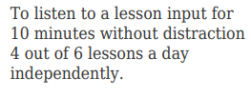
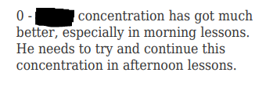



Learning Plans - Reviews
Reviews need to reflect the SMART target and be specific too.
Target:
Review:
Specific review:
0 –
****** concentration has improved. He will listen for 10 minutes in morning lessons but needs reminders for afternoon lessons. He can do this for about 3 out of 6 lessons.
This Photo by Unknown Author is licensed under CC BY-NC

Slide 4
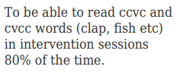
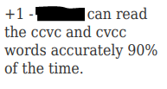
Good example:
Target:
Specific review:
Other info: The data information on our learning plans has been removed.
This Photo by Unknown Author is licensed under CC BY-NC

Slide 5

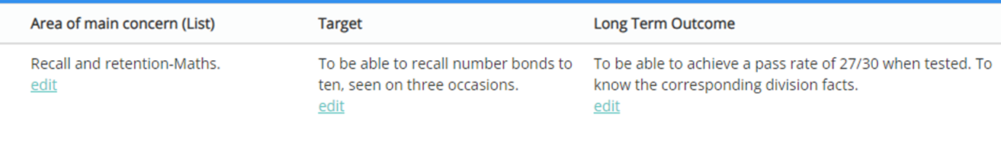


Learning Plans - Target outcomes
Think of ‘long term outcomes’ as where you want them to be in that area at the end of the year/key stage.
They are NOT another target!
***** will be able to recall all multiplication and division facts to 12 x 12.
***** will be age-related in maths by the end of Year 2.

Slide 6
Rest of PDM
Look at each learning plan for the children you have.
Either make notes on any changes you want to make or do a review of the learning plan today (saves you doing it in the last week of term!)
Check/amend the areas of concern and areas of strength.
Check the long term outcomes for each target – are they a repeat of a target or are they ‘top of the ladder’ (end of year/key stage)?
Review targets
Archive and Clone
Change dates on NEW plan (from date you are reviewing to 20th Dec 2023)
Change targets if needed
Complete intervention overviews and add provisions to Edukey

