Slide 1
We want ALL our children to not just manage and cope, but to be successful and feel what success feels like.

Slide 2
Adapting lessons to make them accessible to all!
January 2023

Slide 3

The possible danger behind this is that it may lead to a lowering of expectations, particularly when in-class groupings are permanent, e.g. ‘the bottom group’ receives a different task to everyone else, regardless of the particular needs or aptitudes of the pupils in this area of learning.
For example, while the class are labelling the features of medieval castles, a group of students are colouring in a castle.
What is
differentiation?
Differentiation, as referred to by Ofsted and the DfE, means the provision of different types or levels of activities for specific pupils or groups of pupils.

Slide 4
Over the past few years, ​‘differentiation’ has become an increasingly unpopular term in teaching. Most likely, it was an unintended consequence of an accountability system that incentivised teachers to ​‘prove’ they were differentiating by generating multiple worksheets or by organising mini-lessons for different groups.
Differentiation is an important factor to consider when adapting teaching. It is helpful to draw a distinction between differentiating by outcomes and differentiated support. Whilst providing focused support to children who are not making progress is recommended, creating a multitude of differentiated resources is not.

Slide 5
What is adaptive teaching?
Adaptive teaching benefits ALL learners!
Essentially, it begins by having the same learning intentions for all pupils, with no lowering of expectations. For all pupils to be able to achieve these learning intentions, it will be necessary to ‘adapt teaching’ to ensure access through the use of strategies such as:
Breaking down content into smaller chunks or steps
Varying levels of support, including effective support from TAs as well as the teacher
Removing unnecessary expositions, i.e. clear and simple language, with visual support
Supporting different means of expression and action, such as utilising technology
Intervening appropriately, i.e. in the classroom/lesson wherever possible, to minimise the need for out-of-class interventions (though these will still be appropriate and necessary for some pupils)

Slide 6
What is adaptive teaching?
Examples might include:
Checking on the understanding after a whole class introduction, and providing access to key information to support the learning
Directing a TA to scaffold the learning for a specific pupil or group of pupils
Observing when a pupil or group of pupils seems to be struggling with a new concept or idea, and creating opportunities to dig deeper into any misconceptions that may have arisen, before these have the chance to become entrenched

Slide 7



How exactly do we adapt lessons?
What sort of adaptations are we talking about?
How could we adapt this learning intention for these animals?

Slide 8
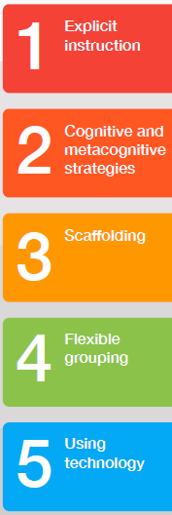
The Five a Day!
Research shows these 5 approaches add maximum value for learners with SEN.
You are probably doing many of them already.
They are relatively easy to adopt and add into your practice.
They will benefit all learners, not just those with SEN.

Slide 9

One of the most important principles of effective teaching, explicit instruction ensures instructions are clear and complete and that pupils are given feedback on tasks. The EEF recommends that teachers use explicit instruction effectively by:
sharing knowledge using clear explanations, simple language and relatable examples – show and tell what you want pupils to think
modelling for pupils what application of knowledge and engagement in learning activities looks like
carrying out frequent check-ins with pupils to consolidate and check on understanding
showing pupils how to put learning into practice within a task before encouraging independent practice

Slide 10
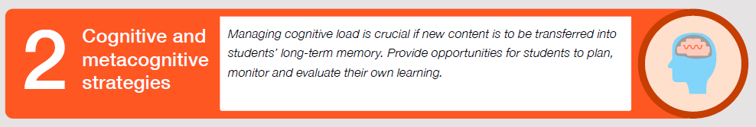
Cognitive teaching is a method of teaching that encourages pupils to effectively use their thought processes. It is constructive and encourages pupils to actively engage in the learning process. Metacognition encourages pupils to think about their own thinking and learning strategies and how they can best utilise these in problem-solving, critical thinking and decision making. The EEF recommends that teachers use cognitive and metacognitive instruction effectively by:
managing cognitive load: don’t expect pupils’ working memory to hold too much information all at once
providing opportunities for pupils to consolidate and ‘download’ information into their long-term memory, freeing up space in their short-term memory, e.g. using our knowledge boxes.
allowing pupils time and space to plan, monitor and evaluate their own learning (metacognition), and identify where they may need extra support

Slide 11
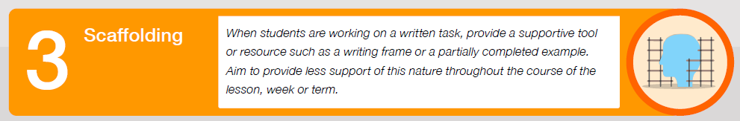
In scaffolding, learning is broken down into digestible chunks of learning and a tool or support structure is provided for each ‘chunk’ to help the learner access and complete the task. The EEF recommends that teachers use scaffolding effectively by:
providing scaffolding to learning through writing frames, partially completed answers, discussion or clues as pupils work through tasks
gradually reducing the amount of scaffolding both within and between lessons, although be ready to return to increased scaffolding on topics that pupils may find more difficult or where information may have dropped out of long-term memory

Slide 12
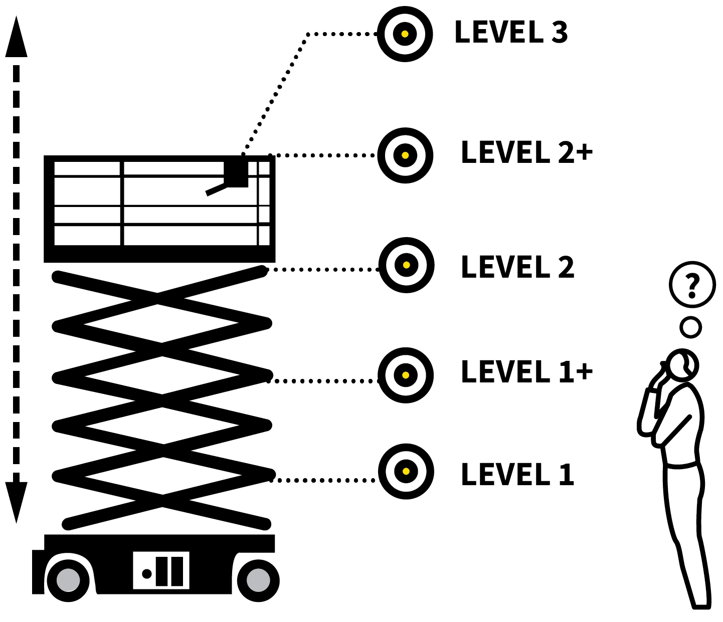
SCAFFOLDING
1
2
3
4
5
PREPARE SCAFFOLDING SETS OFFERING VARYING LEVELS OF SUPPORT
Set everyone a common goal of producing work to a high standard but give students the level of scaffolding appropriate for their level of confidence.
It can work for students to select their own level but this needs careful monitoring.

Slide 13
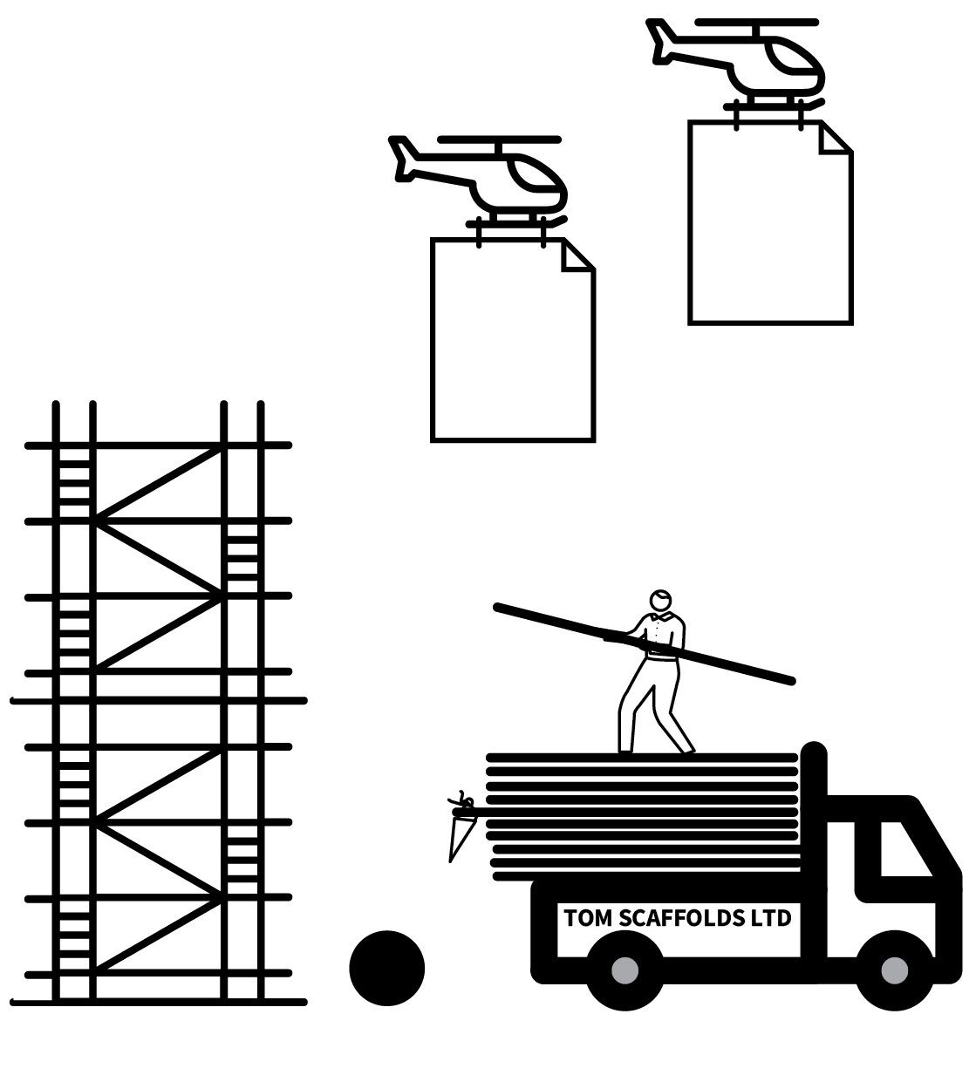
SCAFFOLDING
1
2
3
4
5
TAKE THE SCAFFOLDING DOWN
The classic sequence in modelling and scaffolding is: I do it; We do it; You do it.
The culmination of an instruction and practice phase should be that students attempt a task independently.
If the scaffolding has achieved its purpose, this can be a confidence boosting moment.

Slide 14
Break down a task into steps that students will need to follow in order to
achieve success.
Guided practice.
Word lists, knowledge organisers, sentence starters or sentence builders,
useful phrases and connectives.
Exemplars of completed or partially completed tasks.
Manipulatives in maths and other concrete resources, e.g. fabrics in science, objects to handle for descriptions in English, sources in history, photos to sequence, practical equipment etc.
Checklists of success criteria, live marking.
Diagrams, concept maps
Sufficient time to process.

Slide 15
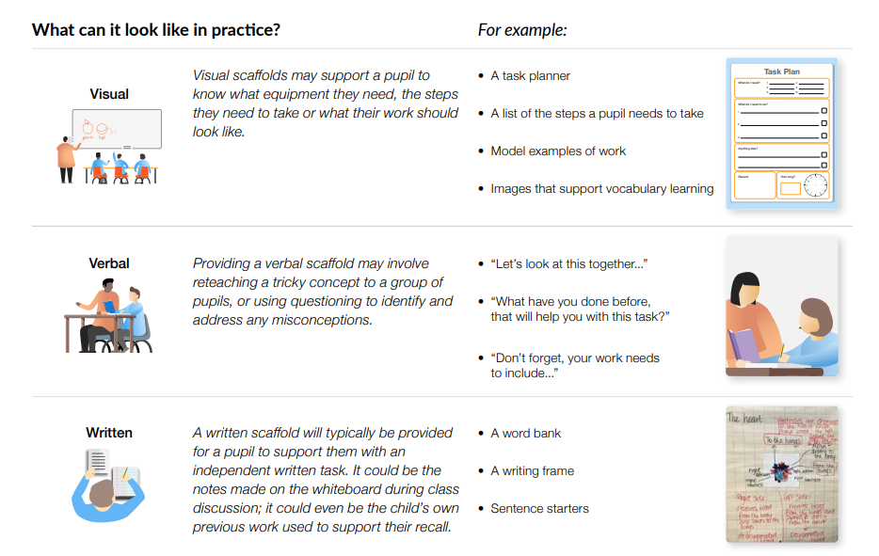

Slide 16

Flexible grouping
Flexible grouping is perhaps the core practice in differentiating tasks and instructions for different learners. It enables groups to be formed based on ability, learning style or interest. Flexible learning allows for groups to flex and change so that pupils can learn effectively while still feeling a part of the wider class. The EEF recommends that teachers use flexible grouping effectively by:
forming pupils at a similar level into a temporary group that splits away from the class to work on a specific area e.g. split inputs or split sessions with a TA like some year groups already do, but this may not be every lesson.
forming mixed-ability groups for certain tasks so pupils can support each other
allowing groups to bend and flex depending on circumstances, and ensuring that pupils also take part in activities as a whole class. At Staniland when TAs may be used for cover, they are off ill, or they need to support an individual child in crisis, you are good at adapting for those lessons and provide that flexibility with groups.

Slide 17

Technology can bring learning to life for pupils, particularly those who learn visually or through interaction. Technology can also go on to support learning outside of the classroom. The EEF recommends that teachers use technology effectively by:
modelling or, as a class, feeding into a worked example on an interactive whiteboard
using video, audio and sensory tools to help pupils engage with concepts
allowing pupils to use keyboards for extensive writing if handwriting is an obstacle to their learning
setting homework on interactive learning programmes, and using video games to increase engagement
directing pupils to helpful websites and apps to enhance their learning

Slide 18
It’s the future we are preparing them for.
Some learners with SEND learn much better when you remove the social interaction.
Examples include:
  Visualisers
  Instructional apps that provide modelling and opportunities to practice skills.
  Non-instructive apps – aids to learning e.g. note taking apps
  Assistive technology – immersive reader etc

Slide 19
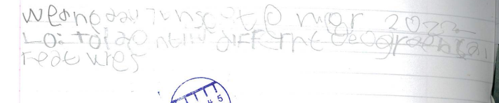
Children with fine motor skills difficulties, may struggle with recording ideas. How many of your children with SEND are exhausted once they've written the date and LI?
Is it a requirement all the time.? What could we do instead?

Slide 20
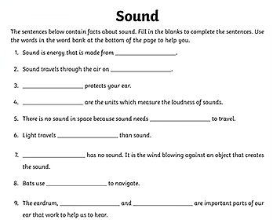
Close procedure is a difficult task for SEND children.
Why?
How could you gather a SEN child's knowledge of sound after their learning experience?

Slide 21
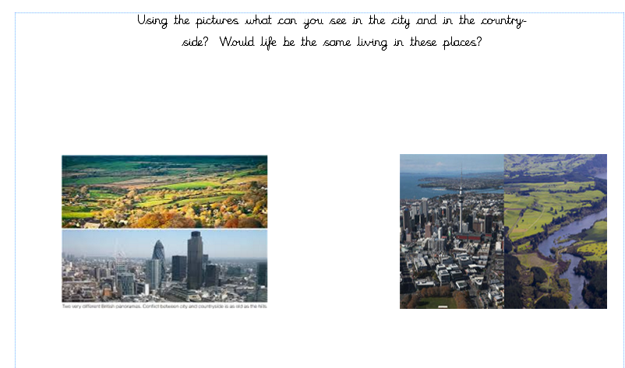
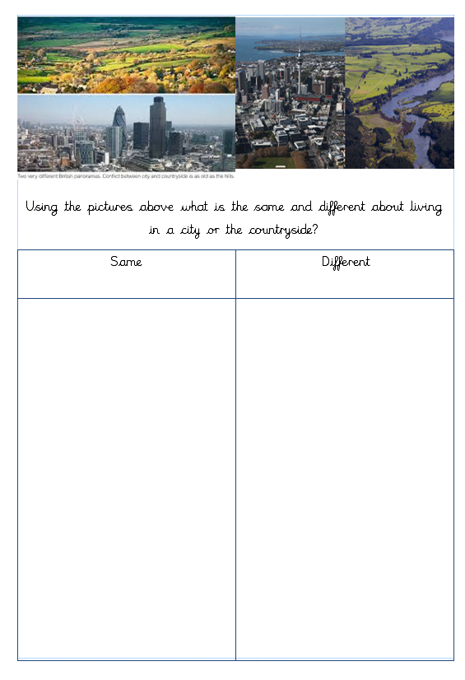
Different ways of making a task accessible.

Slide 22
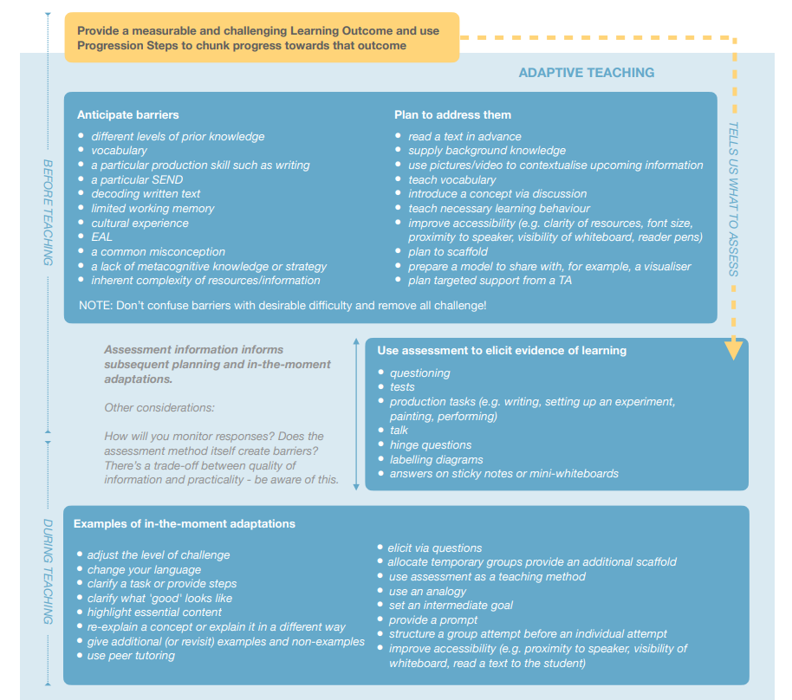
EEF guidance

Slide 23
Accessibility
Changing the terminology from ‘differentiation’ to ‘accessiblity’.
Looking at the ‘five a day’.
Marking and feedback policy – using S when supported.
Focus on scaffolding and using technology.
SLT will be looking at evidence of scaffolding in books/seesaw in the next few weeks.
Consider the place for differentiation within your classroom – there will be a need for it in some lessons, for some children.

Slide 24
Useful Links
EEF blog: Moving from ‘differentiation’ to ‘adaptive teaching’ | EEF (educationendowmentfoundation.org.uk)
EEF Blog: Assess, adjust, adapt – what does adaptive teaching… | EEF (educationendowmentfoundation.org.uk)
Effective Adaptive Teaching (teachwithmrst.com)
Teacher Handbook SEND.pdf (sharepoint)
Staniland Academy Supporting Learners with SEND Nov 22.docx (sharepoint)

